Slide 1
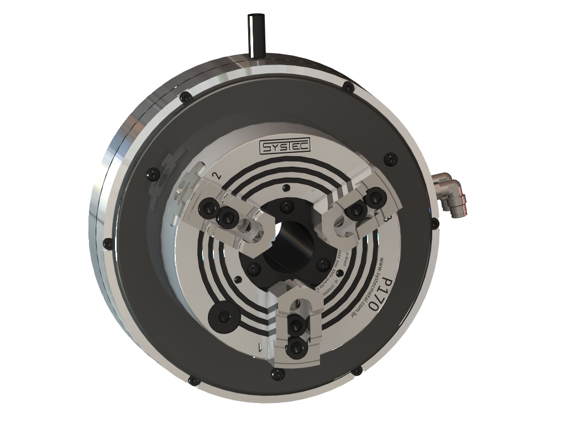
NEW
P 135 - 315
Self contained pneumatic power chuck
www.systecmetal.com.br
Notes:
1

Slide 2
P 135 - 315
P 135 - 315
NEW
Self contained pneumatic power chuck
Self contained pneumatic power chuck
Greater rigidility and durability
Low maintenance, without teflon elements
15% faster
45% more gripping force
Cycle in one half the time
Master jaws serration (1/16”x90° or 1,5mmx60°)
Environmentally friendly
www.systecmetal.com.br
Notes:
2

Slide 3
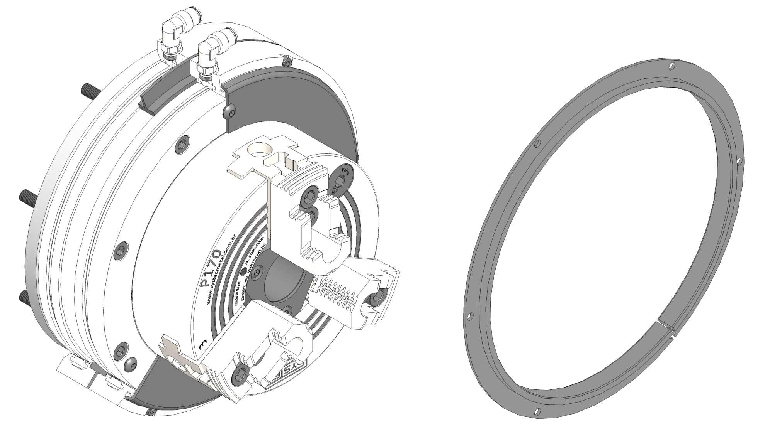
Centering ring
NEW
Low maintenance, no need of adjustment, greater durability, longer life
www.systecmetal.com.br

Slide 4
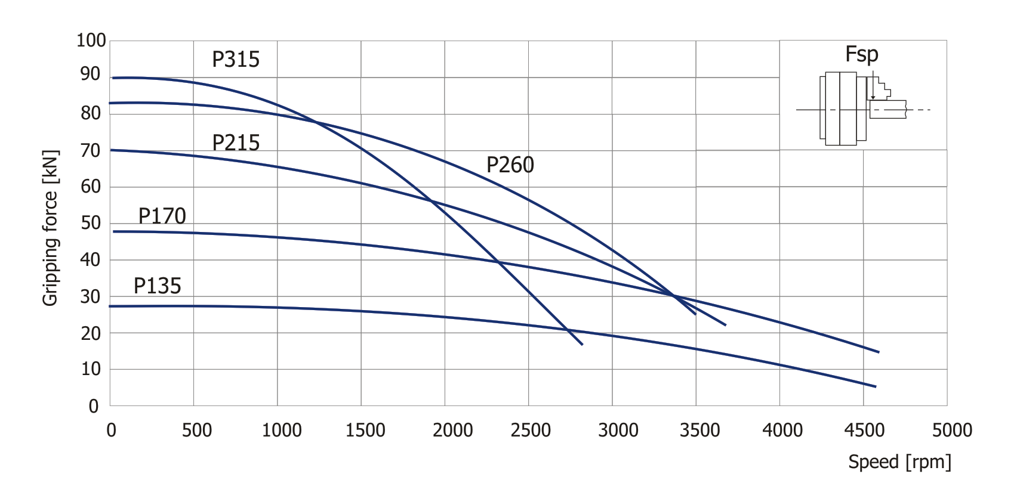
Gripping force curve – P chuck
NEW
www.systecmetal.com.br
Notes:
4

Slide 5
Gripping force curve
Comparisson with other manufactures
NEW
www.systecmetal.com.br
Notes:
5

Slide 6
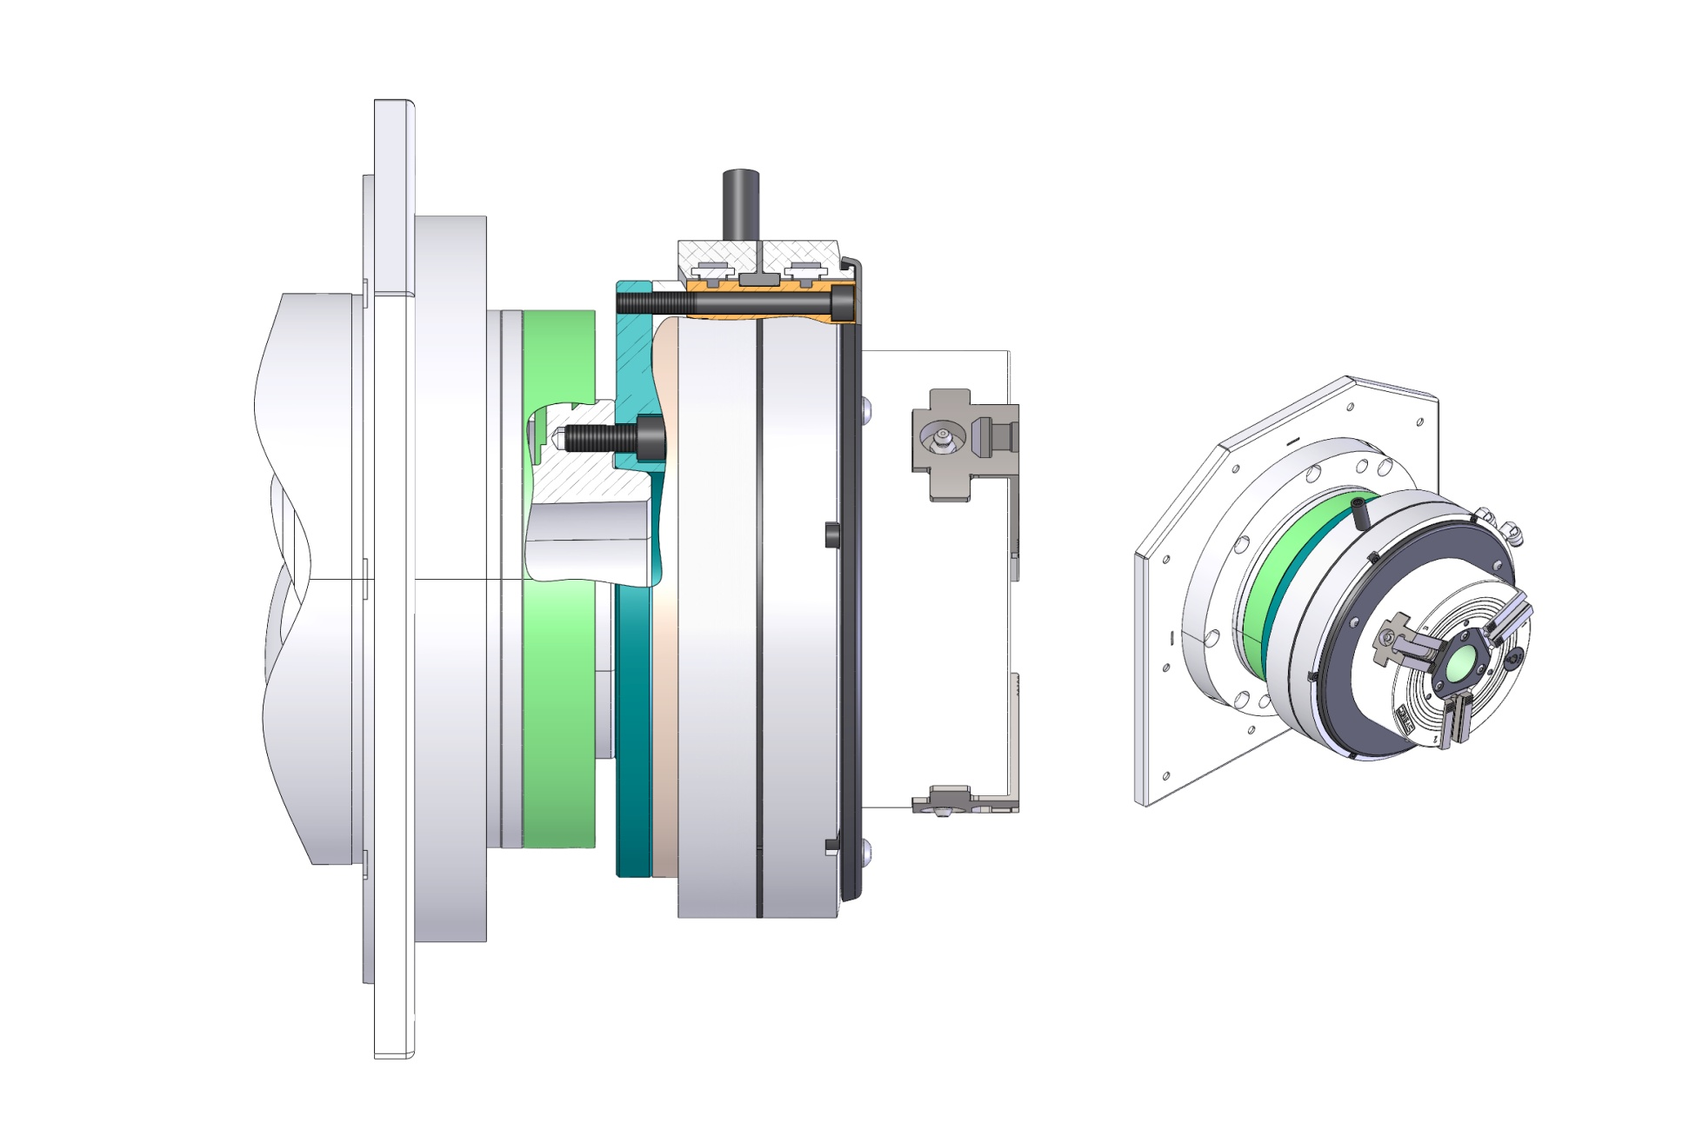
Front mounting
NEW
www.systecmetal.com.br
Notes:
6

Slide 7
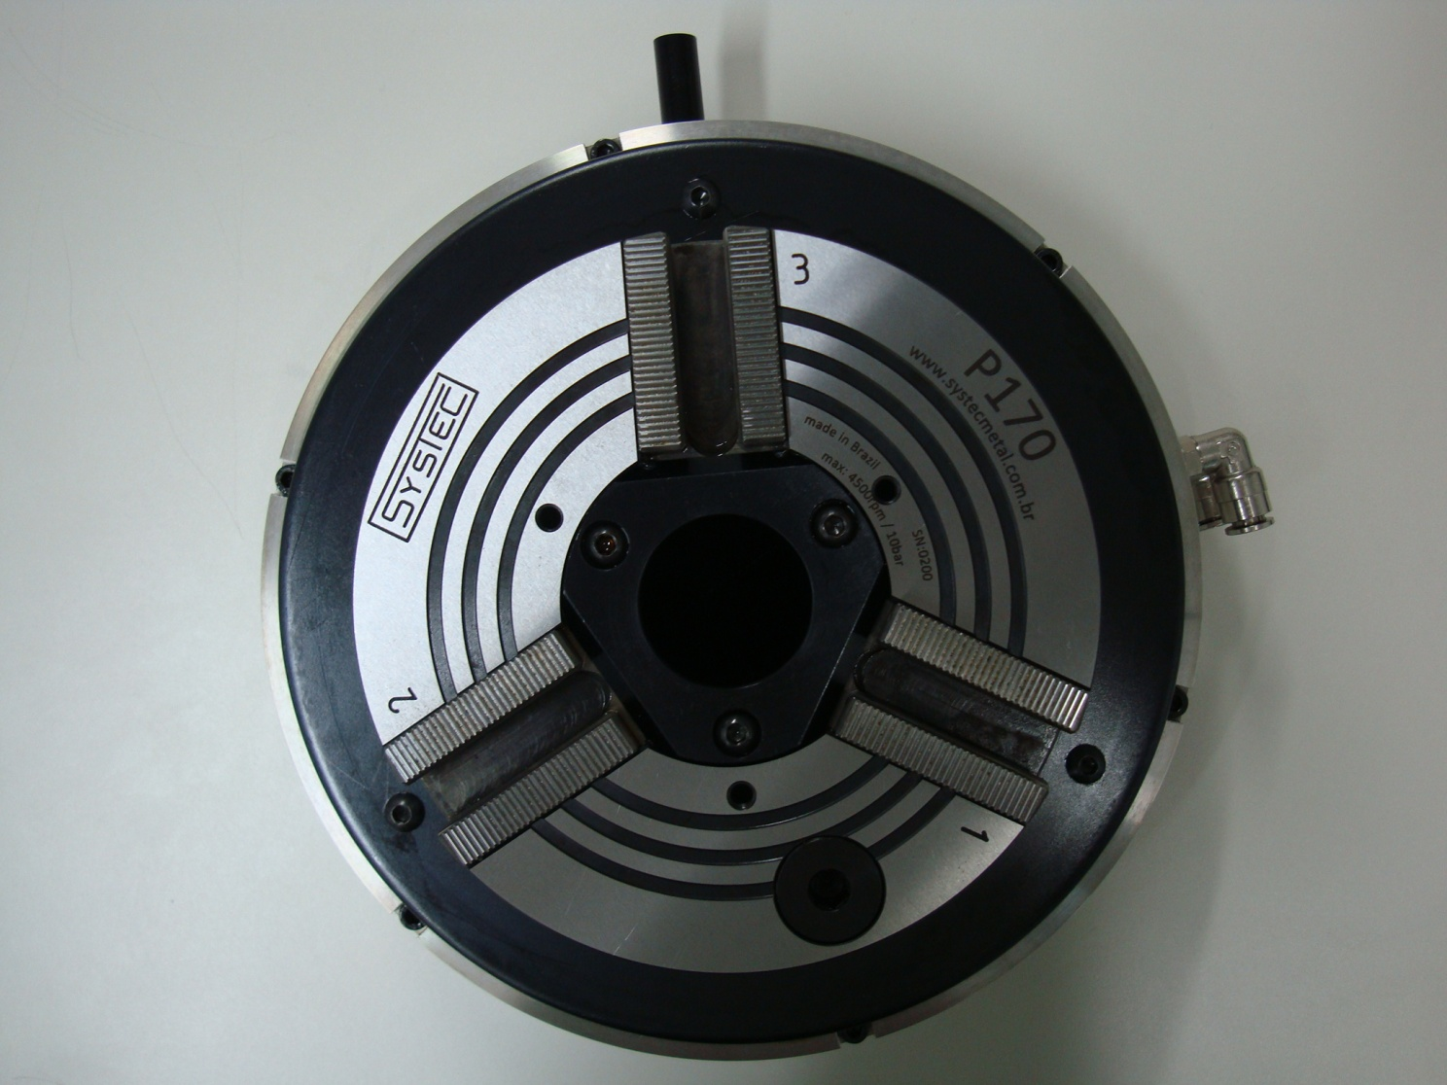
Axial stop or special support
NEW
Tapped holes
www.systecmetal.com.br
Notes:
7

Slide 8
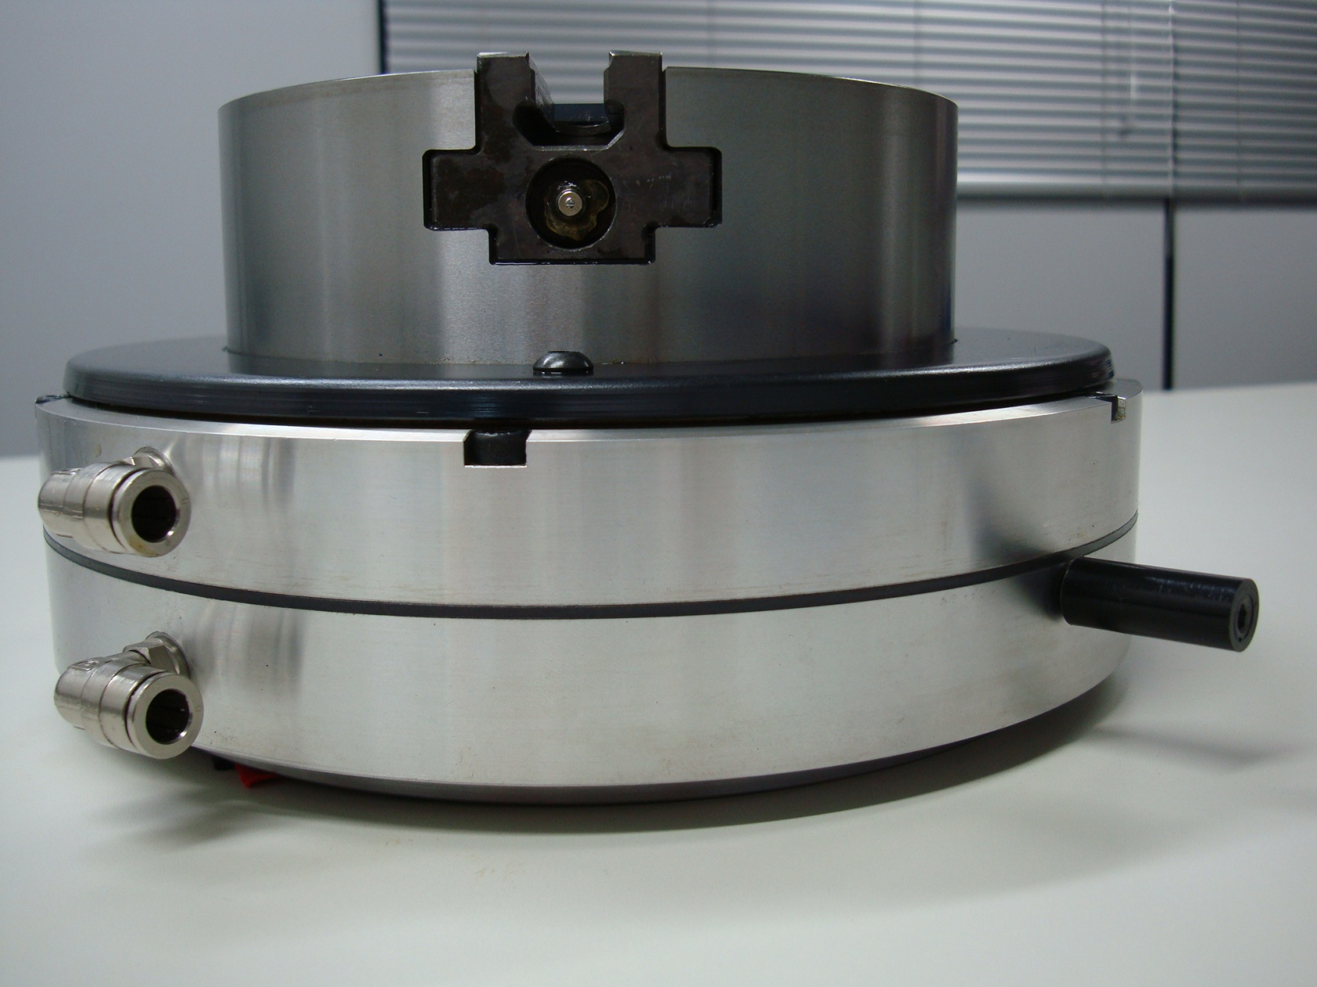
Connections and pin
NEW
Quick change conections
Anti-rotation rubberflex pin
www.systecmetal.com.br
Notes:
8

Slide 9
Master jaw
NEW
P chuck
other chucks
Guide
Guide
www.systecmetal.com.br
Notes:
9

Slide 10
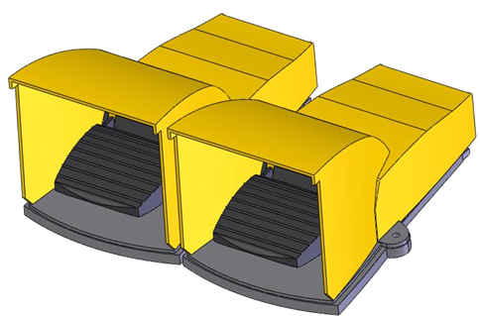
Foot pedal control unit
NEW
Manual foot pedal
Dual foot – Model M2FV
www.systecmetal.com.br
Notes:
10

Slide 11
Demonstration
NEW
Conditions of
machining:
Machine: Centur 30D
Chuck: P 170 with standard hard top jaws Material: AISI 1020
50mm
Ap: 7,5mm (Radial)
Av: 0,28
Speed: 600 rpm
Insert: WNMG r 0.8
Video 1
www.systecmetal.com.br

Slide 12
Demonstration
NEW
Conditions of
machining:
Machine: Centur 30D
Chuck: P 170 with standard hard top jaws
Material: AISI 1020
92mm
Ap: 5,5mm (Radial)
Av: 0,35
speed: 800 rpm
Insert: WNMG r 0.8
Video 2
www.systecmetal.com.br

Slide 13
Demonstration
NEW
Conditions of machining:
Machine: Centur 30D
Chuck: P 170 with standard hard top jaws
Material: AISI 1020
120mm
Ap: 5,5mm (Radial)
Av: 0,35
Speed: 800 rpm
Insert: WNMG r 0.8
Video 3
www.systecmetal.com.br

Slide 14
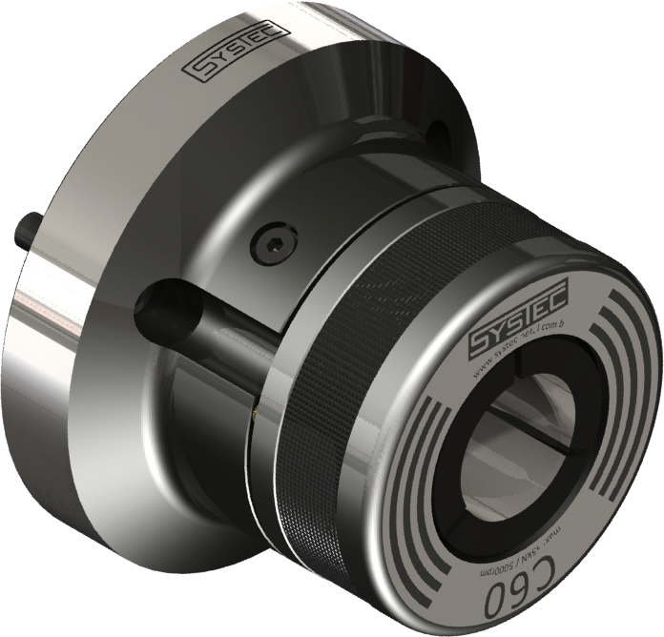
NEW
C 26 – 80
Collet Chuck
www.systecmetal.com.br
Notes:
14

Slide 15
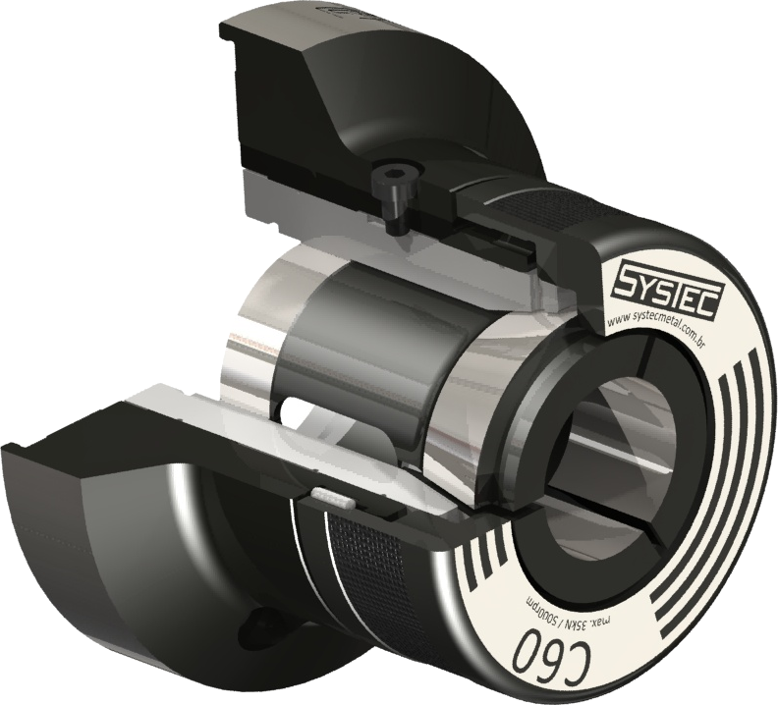
Collet chuck: C 26 - 80
NEW
Quick collet change
Locking cap with bayonet system
For bars Ø 3 – 80 mm
Collet DIN 6343
www.systecmetal.com.br
Notes:
15

Slide 16
Collet chuck: C 26 – 80 (DEMO)
NEW
www.systecmetal.com.br
Notes:
16

Slide 17
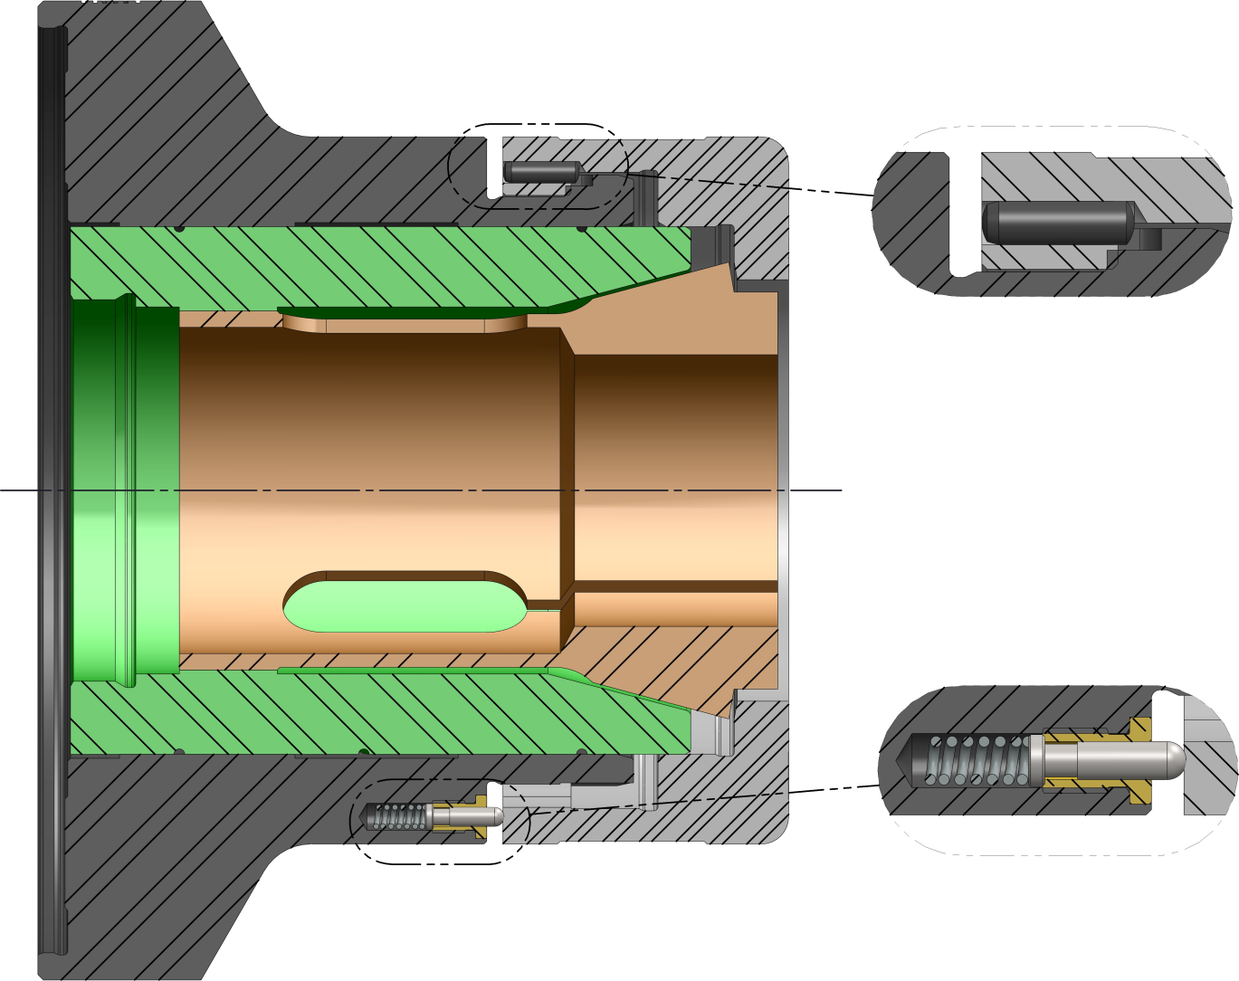
Collet chuck: C
NEW
Pin locks the cap during turning operation
Security system keeps the cap in the corect position
www.systecmetal.com.br
Notes:
17

Slide 18
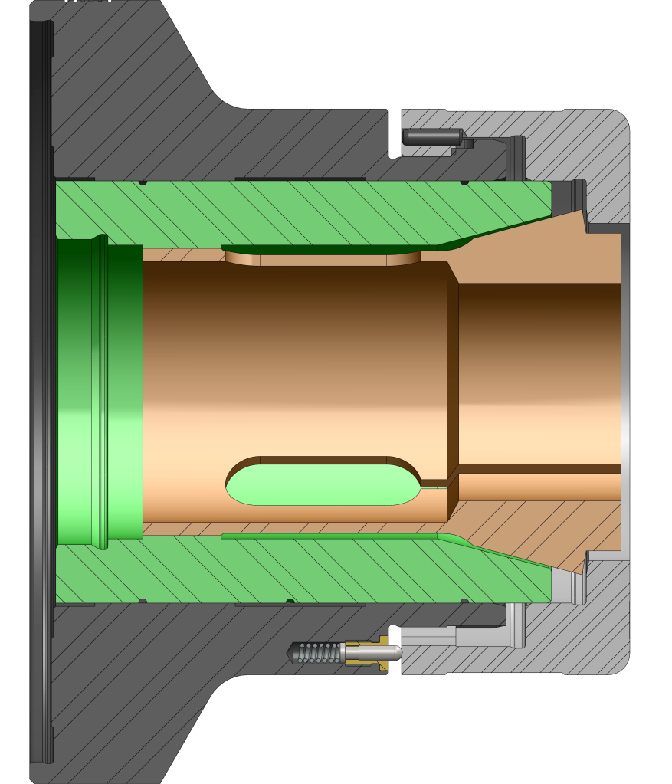
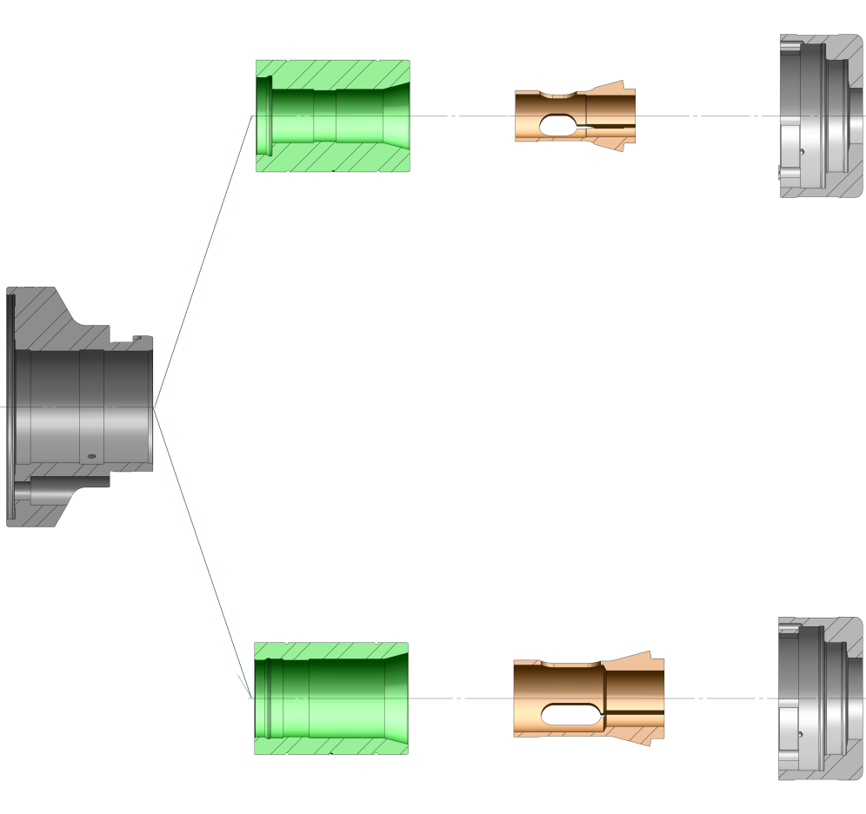
Collet chuck: C 26 / C 42
NEW
wedge C 26
collet C 26
cap C 26
body C 42
cap C 42
wedge C 42
collet C 42
www.systecmetal.com.br
Notes:
18

Slide 19
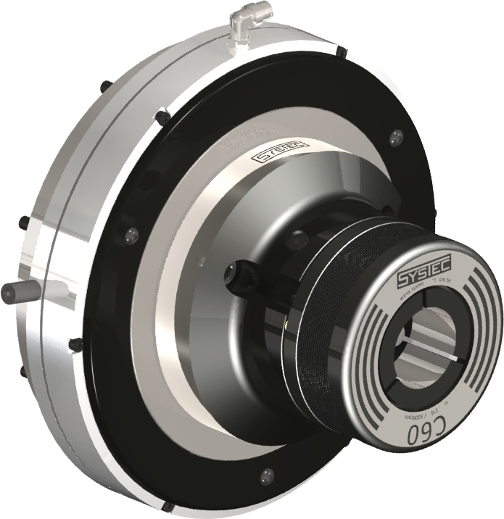
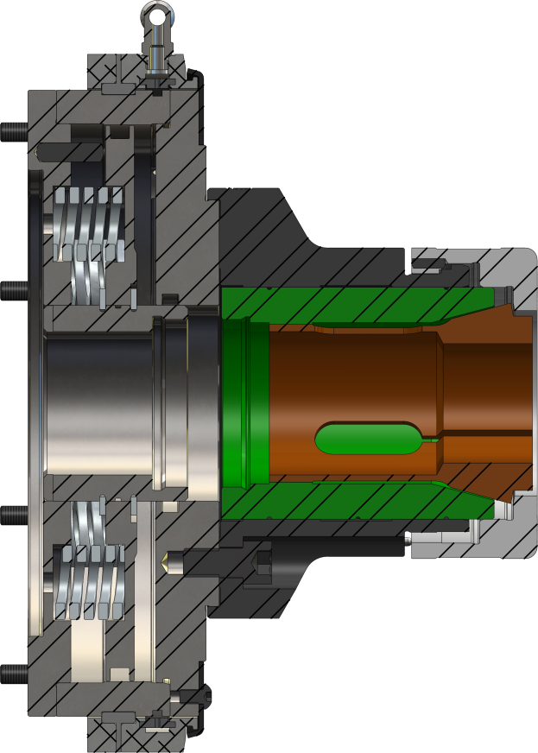
Collet chuck: C Spring/Pneumatic actuated
NEW
Clamp by spring
Unclamp by integrated pneumatic cylinder
Available: C 26 - C 42 - C 60
Front mounting – Self contained
www.systecmetal.com.br
Notes:
19

